Slide 1
533: Supervisor Training Series: Remote Version
Module 1: The Preparatory and Beginning Phases of Child Welfare Supervision
7-16

Slide 2
The Supervisor Training Series
The Preparatory and Beginning Phases of Child Welfare Supervision
Living the Mission of Child Welfare
The Middle/Work Phase of Supervision
Managing Diversity
Endings and Transitions/Managing Staff Retention, Satisfaction, and Separation

Slide 3
Learning Objectives
Participants will be able to:
Examine the transition to a supervisory role by Tuning In to Self and Tuning In to Others;
Describe the three roles of a supervisor: administrative, educational and clinical;
Explore supervision within the child welfare context;
Recognize the impact of parallel process between the supervisor and caseworker on the relationship between the caseworker and the client; and
Explain how a supervisor uses contracting skills.

Slide 4
Agenda
Day One
Introduction
Issues for New Supervisors
The Supervisory Role
The Child Welfare Context
Day Two
The Child Welfare Context (continued)
Development of the Individual Worker
The Beginning Phase of Supervision
Transferring Skills to Practice
Evaluation and Closure

Slide 5
Idea Catcher
Don’t let a good idea get away!
People remember:
20% of what they hear
30% of what they see
70% of what they say
90% of what they do

Slide 6
Dual Feeling of Fraudulence
“We must not let them make us feel like frauds.”
“Let us continue to spot fraudulence in the roles we are asked to play.”
“Used with permission of Peggy McIntosh Ph.D.”

Slide 7
Top Leader Characteristics
Honesty and integrity
Good communicator
Taking charge

Slide 8
Preliminary Supervision Skills
Tuning in (self and others)
Responding directly to indirect cues

Slide 9
Supervision
A social work supervisor has “the authority to:
Direct;
Coordinate;
Enhance; and
evaluate on-the-job performance of the supervisees for whose work he or she is held accountable.”
The supervisor’s ultimate objective is to deliver to agency clients the best possible service, both quantitative and qualitatively, in accordance with agency policies and procedures.”
Source: A. Kadushin

Slide 10
Supervisory Roles
Administrative
Educational
Clinical

Slide 11
Administrative Supervision
Administrative Supervision focuses on those areas of supervision related to the efficient and effective delivery of services.
This module stresses the importance of understanding one’s own management style within the context of the agency’s
mission;
vision;
administrative structure;
goals; and
outcomes.

Slide 12
Educational Supervision
Educational Supervision focuses on preparing more
knowledgeable;
competent; and
confident workers.
It emphasizes the development and/or enhancement of the child welfare professional’s
knowledge and
skills.

Slide 13
Clinical Supervision
Clinical Supervision focuses on the work that caseworkers do with children and families.
Good clinical supervision is in helping workers to attain a high level of performance and is critical to building worker competencies, including
reinforcing positive social work ethics and values;
encouraging self-reflection and critical thinking skills; and
supporting the worker through casework decision-making and crises.
The supervisor and worker together reflect on the skills used and theory applied by the worker with a family in assessing, planning, implementing, and monitoring change.
(Child Information Gateway, 2011)

Slide 14
Supervisory Role Questions
In which supervisory role does the main primary supervisory activity fit best?
What might be an appropriate next step or secondary task for the supervisor?
In which supervisory role does the secondary supervisory task fit best?
What is the risk if the primary role is not the supervisor’s strength and the supervisor is not aware of the role’s importance?

Slide 15
The Parallel Process
A supervisor models a view of helping relationships through his or her interaction with staff.
Source: Lawrence Shulman

Slide 16
The Working Relationship
Rapport- general ability to get along well with the supervisor
Trust- the ability of the worker to be open with the supervisor and to share mistakes and failures, as well as successes
Caring-the perception of the supervisee that the supervisor is trying to help, and cares about the worker, as well as the clients.
(Shulman, 2010)

Slide 17
The Phases of Supervision
Preliminary or Preparatory,
Beginning,
Middle/Work, and
Endings and Transitions.

Slide 18
Goal of Children and Youth Services
To ensure for each child a permanent, legally assured family, which protects the child from abuse and neglect.
(Chapter 3130 Regulations)

Slide 19
Preservation of Reasonable Parenting
The Adoption and Safe Families Act of 1997 states that nothing in the act is "intended to disrupt the family unnecessarily or to intrude inappropriately into family life, to prohibit the use of reasonable methods of parental discipline, or to prescribe a particular method of parenting."

Slide 20
Child and Family Services Review Outcomes
Safety
Children are first and foremost protected from abuse and neglect.
Children are safely maintained in their own homes whenever possible and appropriate.

Slide 21
Child and Family Services Review Outcomes (continued)
Permanency
Children have permanency and stability in their living situations.
The continuity of family relationships and connections will be preserved for children.

Slide 22
Child and Family Services Review Outcomes (continued)
Child and Family Well-Being
Families have enhanced capacity to provide for their children's needs.
Children receive appropriate services to meet their educational needs.
Children receive adequate services to meet their physical and mental health needs.

Slide 23
Agenda
Introduction
Issues for New Supervisors
The Supervisory Role
The Child Welfare Context
Development of the Individual Worker
The Beginning Phase of Supervision
Transferring Skills to Practice
Evaluation and Closure

Slide 24
Continuous Quality Improvement (CQI)
The ongoing process by which an agency makes decisions and evaluates its progress.
Source: The National Resource Center for Organizational Improvement and Casey Family Programs

Slide 25
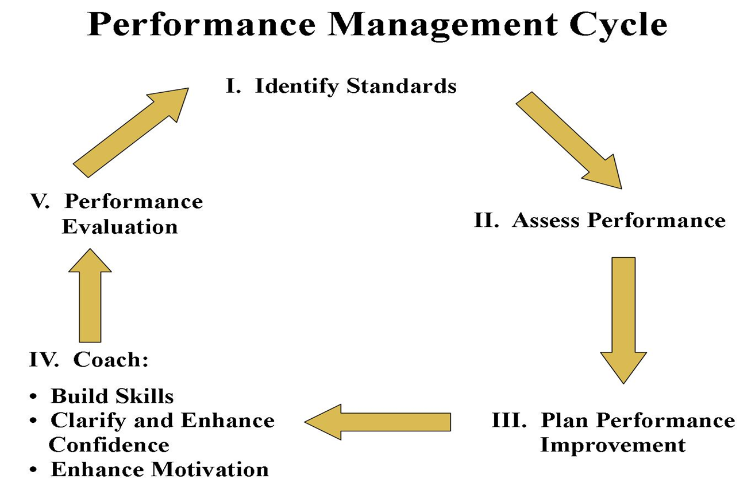

Slide 26
Requirements for Effective Learning
The learner must:
Have a stake in the outcome
Be actively involved in the investigation of ideas
Have structured opportunities for using the information presented

Slide 27
Approach to Teaching Skills
Explain
Demonstrate
Practice
Feedback
Transfer implications and applications

Slide 28
Effective Feedback
Targets the key skills;
Is individualized;
Is motivational and constructive. Identifies both strengths and challenges of the learner, giving examples that illustrate desired behaviors;
Helps the learner integrate knowledge, cognitive strategies, and behaviors;

Slide 29
Effective Feedback (continued)
Gives suggestions for improvement and strategies that can be implemented on the job;
Is both oral and in writing;
Uses a standardized written format that identifies items, strengths, challenges, suggestions for improvement, and strategies for transfer; and
Is from an experienced person or other worker who has been taught to give good feedback.

Slide 30
Principles of Effective Feedback
Feedback should be:
Balanced
Specific
Objective
Relevant to goals
Understandable
Participative
Actionable
Hierarchical

Slide 31
Practice the Approach to Teaching Skills
Select a mandate or standard of practice from those discussed on the first day of training.
Select a discrete segment to teach to a worker.
Select the set of behaviors to teach the worker.
Prepare a plan to teach the worker the skill using the five-step approach to teaching skills.
Post an outline of the plan on flip chart paper.
Prepare to present the plan through description and illustration.

Slide 32
Key Skills of Contracting
The supervisor sharing his or her sense of purpose;
Describing the supervisor’s role;
Eliciting feedback from the workers on their perceptions; and
Discussing the mutual obligations and expectations related to the supervisor’s authority.
Source: Lawrence Shulman

Slide 33
Key Areas of Orienting a New Worker
The agency and its policies and procedures;
The unit or department;
The larger staff system;
The supervisor; and
The service recipients.

Slide 34
Getting Better Responses to Questions
Give employees time to think about their responses.
Tell employees what’s at stake, why you need this information.
When you’re done asking, be quiet and listen.
Used under Fair Use from the following source: Effective Coaching, Marshall J. Coo

Slide 35
Solution-Focused Phrasing
“How come?”
“How is it that you…?”
“What tells you that …?”

Slide 36
Strengths-Based, Solution-Focused Questions
Past successes
Exception finding question
Miracle questions (with follow-up)
Scaling questions (with follow-up)

Slide 37
The Task
As a large group, develop a script of the meeting between the supervisor and worker regarding the pattern of behavior.
Consider whether going back to contracting with the worker would be beneficial.
Use the guidelines for asking good questions and one of the types of solution-focused questions, as assigned.

